Slide 1


Network protocols & security
24EC2210
Topic:
Quality of service
Session - 29

Slide 2
AIM OF THE SESSION
To familiarize students with the basic concept of Quality of Service
INSTRUCTIONAL OBJECTIVES
This Session is designed to:
1. Introduction to Quality Of Service
2. Various Techniques of QOS
LEARNING OUTCOMES
At the end of this session, you should be able to:
1. Describe the concepts of Quality Of Service
2. List out different Techniques of QOS

Slide 3
AGENDA
Quality of Service​
Techniques To Improve QOS

Slide 4
Quality of service
A stream of packets from a source to destination is called a flow.
In a connection-oriented network, all the packets belonging to a flow follow the same route.
In a connectionless network, they may follow different routes.
The needs of each flow can be characterized by four primary parameters: reliability, delay, jitter and bandwidth.
Together these determine the QOS (Quality Of Service) the flow requires.

Slide 5
Techniques TO IMPROVE QOS
1. Over provisioning
2. Buffering
3. Traffic shaping
i. The leaky bucket algorithm
ii. Token Bucket algorithm
4. Packet scheduling
5. Admission control
6. Integrated services
i. RSVP – Resource Reservation Protocol
7. Differentiated services
i. Expedited forwarding
ii. Assured forwarding

Slide 6
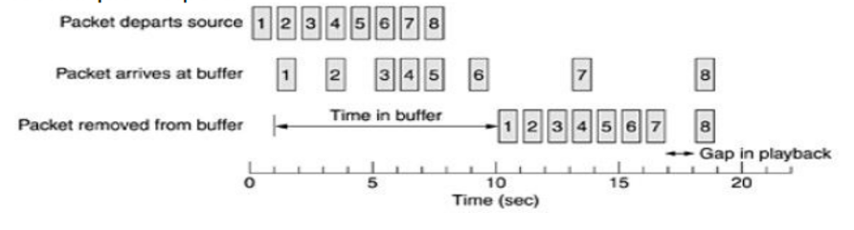
Qos TECHNIQUE – OVERPROVISIONING
Overprovisioning:
An easy solution is to provide so much router capacity, buffer space and bandwidth that the packets just fly through easily.
The trouble with this solution is that it is expensive.

Slide 7
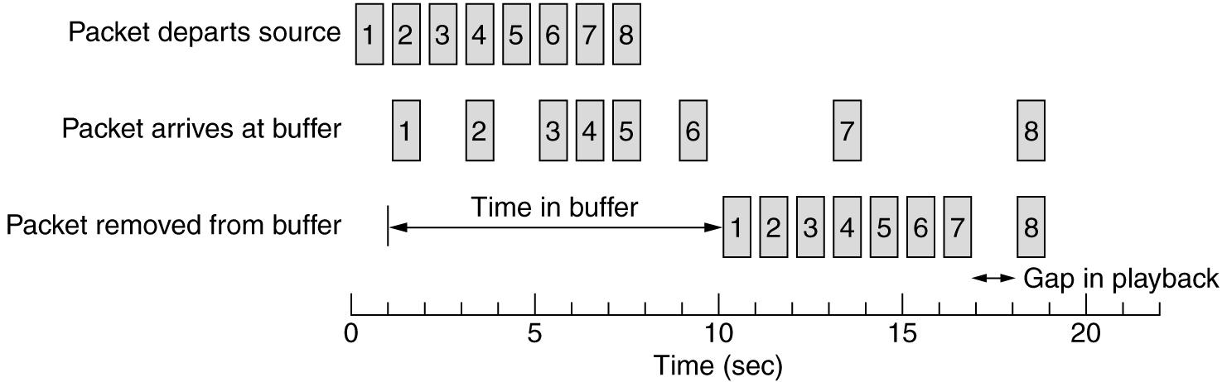
Qos TECHNIQUE – BUFFERING
Buffering:
Flows can be buffered on the receiving side before being delivered.
Buffering them does not affect the reliability or bandwidth and increases the delay, but it smooths out the jitter.
For audio and video on demand, jitter is the main problem, so this techniques helps a lot.
Smoothing the output stream by buffering packets.

Slide 8
Traffic Shaping

Slide 9
Qos technique – traffic shaping
Traffic Shaping is a mechanism to control the amount and the rate of the traffic sent to the network.
Approach of congestion management.
Traffic shaping helps to regulate rate of data transmission and reduces congestion.
There are 2 types of traffic shaping algorithms:
Leaky Bucket
Token Bucket
Monitoring a traffic flow is called traffic policing.

Slide 10
LEAKY BUCKET ALGORITHM

Slide 11
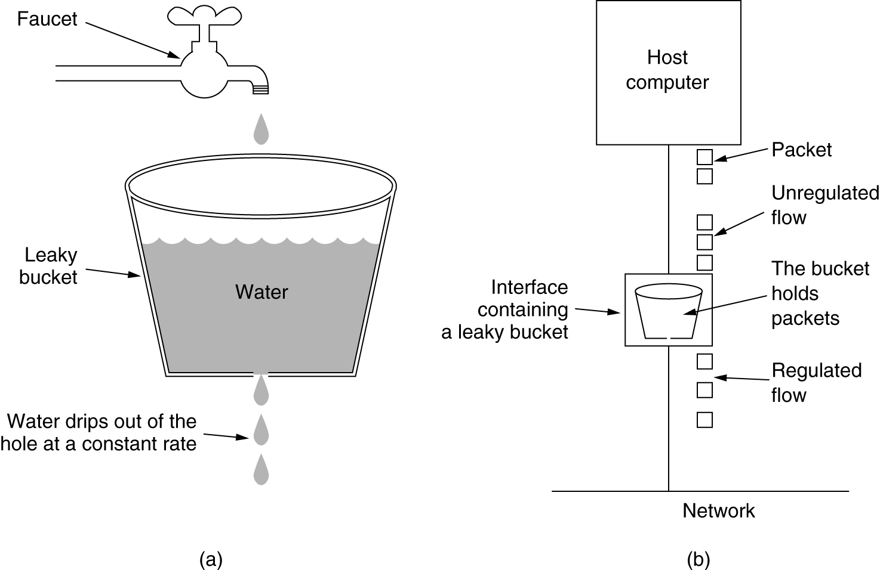
Qos technique – traffic shaping Leaky Bucket
Suppose we have a bucket in which we are pouring water in a random order but we have to get water in a fixed rate, for this we will make a hole at the bottom of the bucket.
It will ensure that water coming out is in a fixed rate, and also if bucket will full we will stop pouring in it. The input rate can vary, but the output rate remains constant.
Similarly, in networking, a technique called leaky bucket can smooth out bursty traffic. Bursty chunks are stored in the bucket and sent out at an average rate.

Slide 12
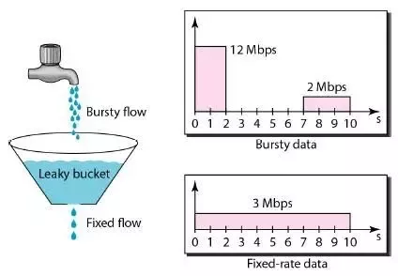
Qos technique – traffic shaping Leaky Bucket

Slide 13
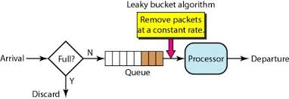
Implementation of Leaky bucket algorithm
A simple leaky bucket algorithm can be implemented using FIFO queue.
A FIFO queue holds the packets.
If the traffic consists of fixed-size packets, the process removes a fixed number of packets from the queue at each tick of the clock.
If the traffic consists of variable-length packets, the fixed output rate must be based on the number of bytes or bits.

Slide 14
TOKEN BUCKET ALGORITHM

Slide 15
Qos technique – traffic shaping TOKEN Bucket
The leaky bucket algorithm enforces output patterns at the average rate, no matter how busy the traffic is.
So, to deal with the more traffic, we need a flexible algorithm so that the data is not lost. One such approach is the token bucket algorithm.
Let us understand this algorithm step wise as given below −
Step 1 − In regular intervals tokens are thrown into the bucket f.
Step 2 − The bucket has a maximum capacity f.
Step 3 − If the packet is ready, then a token is removed from the bucket, and the packet is sent.
Step 4 − Suppose, if there is no token in the bucket, the packet cannot be sent.

Slide 16
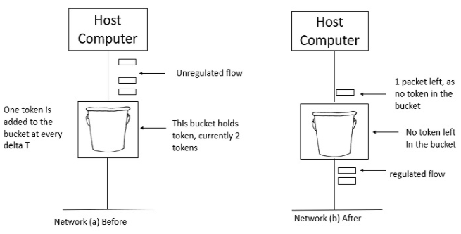
Token Bucket
In figure (a) the bucket holds two tokens, and three packets are waiting to be sent out of the interface.
In Figure (b) two packets have been sent out by consuming two tokens, and 1 packet is still left.

Slide 17
Qos technique – traffic shaping TOKEN Bucket Implementation
When compared to Leaky bucket the token bucket algorithm is less restrictive that means it allows more traffic.
The limit of busyness is restricted by the number of tokens available in the bucket at a particular instant of time.
The implementation of the token bucket algorithm is easy −
A variable is used to count the tokens.
For every t seconds the counter is incremented and then it is decremented whenever a packet is sent.
When the counter reaches zero, no further packet is sent out.

Slide 18
Packet Scheduling

Slide 19
Qos technique – packet scheduling
If a router is handling multiple flows, there is a danger that one flow will take too much of its capacity and starve all the other flows.
Packet scheduling algorithms can be devised to minimize it.
One of the first ones was the fair queueing algorithm.
The essence of the algorithm is that routers have separate queues for each output line, one for each flow.
When a line becomes idle, the router scans the queues round robin, taking the first packet on the next queue.

Slide 20
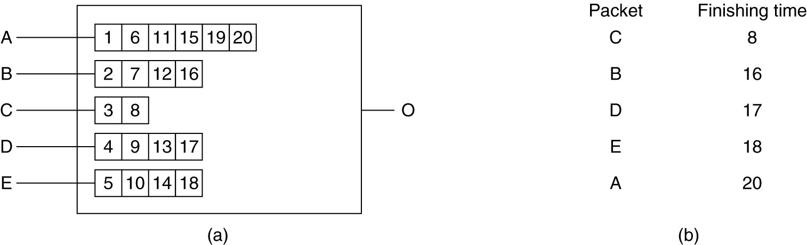
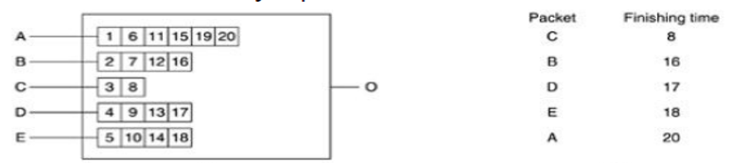
Qos technique – packet scheduling
In this way, with n hosts competing for a given output line, each host gets to send one out of every n packets.
Figure: Fair queueing
(a) A router with five packets queued for line O.
(b) Finishing times for the five packets.

Slide 21
Admission Control

Slide 22
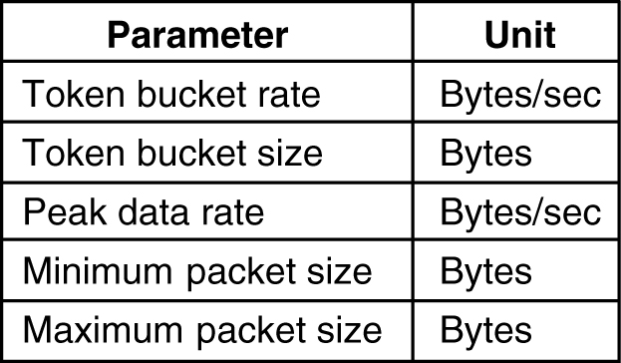
Qos technique – admission control
Generally, the sender produces a flow specification proposing the parameters it would like to use.
As the specification propagates along the route, each router examines it and modifies the parameters as need be.
The modifications can only reduce the flow, not increase it.
When it gets to the other end, the parameters can be established.

Slide 23
Integrated Services

Slide 24
Qos technique – integrated services
Flow-based algorithms or integrated services is aimed at providing QOS both unicast and multicast applications.
RSVP – Resource reSerVation Protocol:
The main protocol for integrated services architecture is RSVP.
This protocol is used for making reservations.
RSVP allows multiple senders to transmit to multiple groups of receivers, permits individual receivers to switch channels freely and optimizes bandwidth use while at the same time eliminating congestion.
In its simplest form, the protocol uses multicast routing using spanning trees.

Slide 25
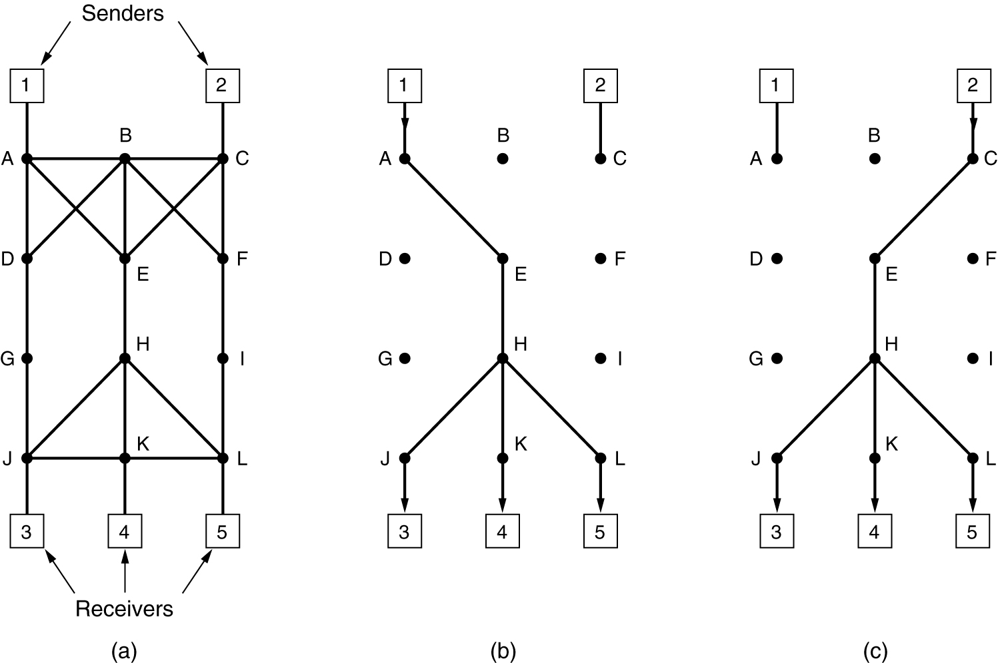
Qos technique – integrated services RSVP-The ReSerVation Protocol

Slide 26
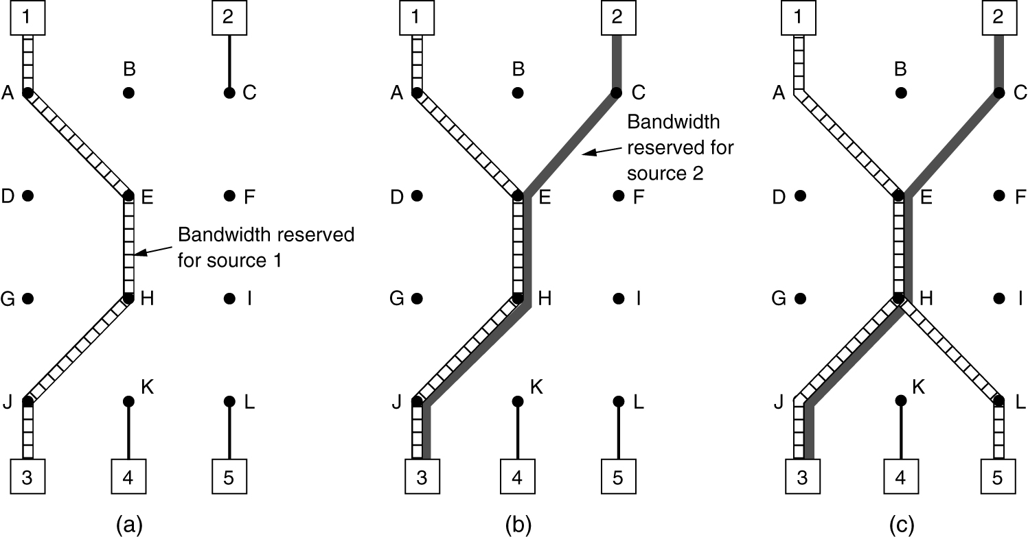
Qos technique – integrated services RSVP-The ReSerVation Protocol

Slide 27
Qos technique – integrated services RSVP-The ReSerVation Protocol
To get better reception and eliminate congestion, any of the receivers in a group can send a reservation message up the tree to the sender.
The message is propagated using the reverse path forwarding algorithm.
At each hop, the router notes the reservation and reserves the necessary bandwidth.
If insufficient bandwidth is available, it reports back failure.
By the time the message gets back to the source, bandwidth has been reserved all the way from the sender to the receiver making the reservation request along the spanning tree.

Slide 28
Differentiated Services

Slide 29
Qos technique – differentiated services
Flow-based algorithms have the potential to offer good QOS to one or more flows because they reserve whatever resources are needed along the route.
They require an advanced set up to establish each flow, something that does not scale well when there are thousands or millions of flows.
For these reasons, a simpler approach is devised for QOS, one that can be largely implemented locally in each router without advance setup and without having the whole path involved.
This approach is known as class-based QOS and the architecture is called differentiated services.

Slide 30
Qos technique – differentiated services
Expedited forwarding:
The choice of service classes is up to each operator, but since packets are often forwarded between subnets run by different operators, IETF(Internet Engineering Task Force) is working on defining network independent service classes.
The simplest class is expedited forwarding.
Two classes of service are available: regular and expedited
The vast majority of the traffic is expected to be regular, but a small fraction of the packets are expedited.

Slide 31
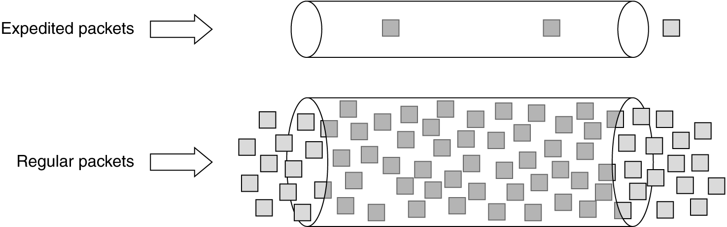
Qos technique – differentiated services Expedited Forwarding
Expedited packets experience a traffic-free network.

Slide 32
Qos technique – differentiated services Assured forwarding:
Assured forwarding:
A somewhat more elaborate scheme for managing the service classes is called assured forwarding.
It specifies that there shall be four priority classes, each class having its own resources.
In addition, it defines three discard probabilities for packets that are undergoing congestion: low, medium and high.
Taken together, these two factors defines 12 service classes.

Slide 33
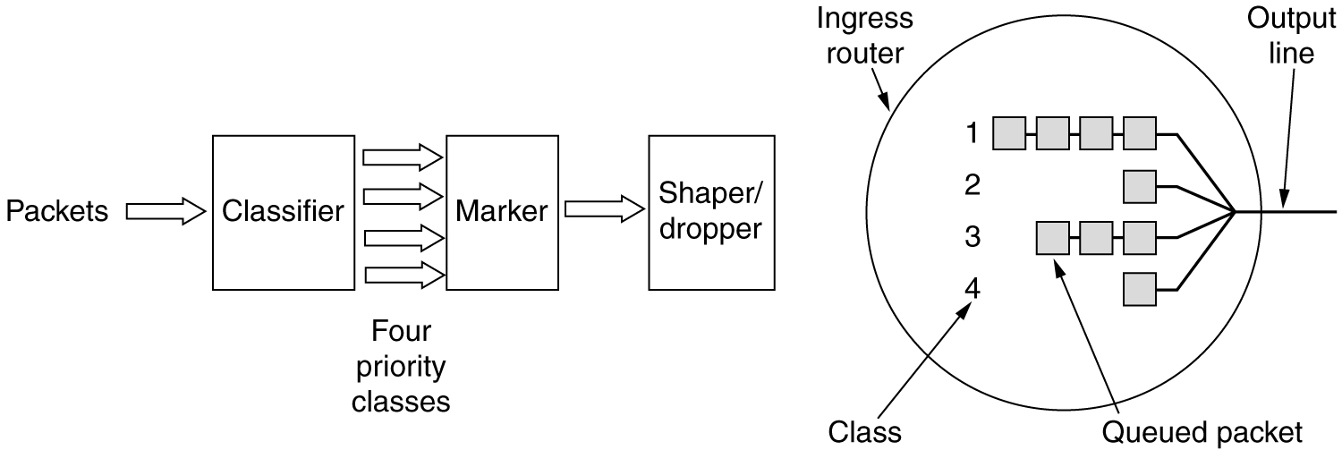
Qos technique – differentiated services Assured forwarding:
Assured forwarding:
A possible implementation of the data flow for assured forwarding.

Slide 34
Qos technique – differentiated services Assured forwarding:
Step-1 is to classify the packets into one of the four priority classes.
This step might be done on the sending host or in the ingress router.
The advantage of doing classification on the sending host is that more information is available about which packets belong to which flows there.
Step-2 is to mark the packets according to their class. A header field is needed for this purpose.
Step-3 is to pass the packets through a shaper/dropper filter that may delay or drop some of them to shape the four streams into acceptable forms, for example, by using leaky or token buckets.
If there are too many packets, some of them may be discarded here, by discard category.

Slide 35
REFERENCES FOR FURTHER LEARNING OF THE SESSION
TEXTBOOKS:
1. Data Communications and Networking(3rd Edition) – B A Ferouzan – TMH
2. Computer Networks (4th Edition) – A S Tanenbaum - Pearson Education/PHI
Reference Books:
Data Communications and Networking(5th Edition) – W. Stallings - Pearson Education/PHI
Network for Computer Scientists & Engineers, Zheng & Akhtar, OUP
WEB REFERNCES/MOOCS:
Kurose and Rose – “Computer Networking -A top down approach featuring the internet”– Pearson Education
“Communication Networks” – Leon, Garica, Widjaja TMH
“Internetworking with TCP/IP, Comer – vol. 1, 2, 3(4th Ed.)” – Pearson Education/PHI
https://www.tutorialspoint.com/what-is-closed-loop-congestion-control/
https://www.geeksforgeeks.org/congestion-control-techniques-in-computer-networks/3.

Slide 36
THANK YOU
Team – NETWORK PROTOCOLS AND SECURITY

